Slide 1

Personal Loan Modelling
Group assignment
Jade Reyes & Jes Colbourne

Slide 2


Business Context
TB
THERA BANK
These are targeted ads because an algorithm – based on your history, thinks you’re more likely to respond what they’re advertising
Thera Bank (fictional) wants to explore ways to getting more personal loan customers
More people to expose these ads to requires more budget

Slide 3




Business Question
Develop a classification model which will allow Thera Bank’s marketing team to maximise conversion rate of Personal Loan Campaign by limiting the target audience with minimal budget.

Slide 4
Data
INTEGER/STRING
BOOLEAN (1 or 0)
Age ( Customer’s Age in years)
Experience(Number of years in professional experience)
Annual Income of customer
Zip Code
Family (Family size of customer)
CCAverage (Avg spending on credit card per month)
Education (Undergrad, Graduate, Advance/Professional)
Value of house mortgage
Personal Loan
Securities Account
Online
CD Account
Credit Card
Target Variable
https://www.kaggle.com/datasets/teertha/personal-loan-modeling?select=Bank_Personal_Loan_Modelling.csv

Slide 5
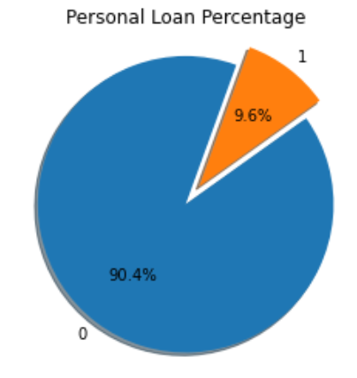
Data
JES’ Approach
Randomly sampled 400 datasets for both populations
Joined these 2 x 400 data set into one dataset
Performed train test split on this 800 dataset
Trained the model in this data set
JADE’s Approach
Imported “SMOTE” from imblearn.over_sampling
SMOTE - Synthetic Minority Over-sampling Technique
This creates more synthetic entries of the minority to match up number of majority class
From 5000 data point this increased to 9,040 data points

Slide 6
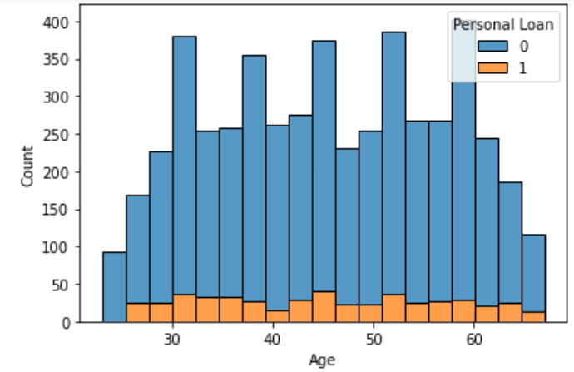
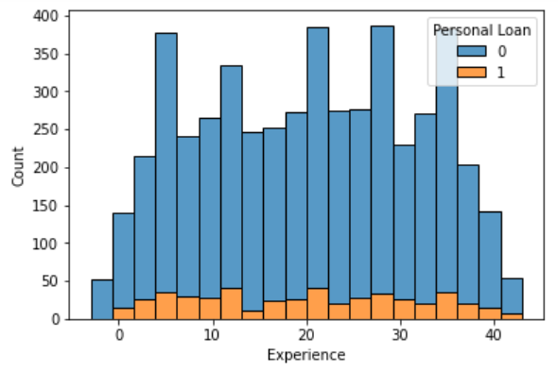
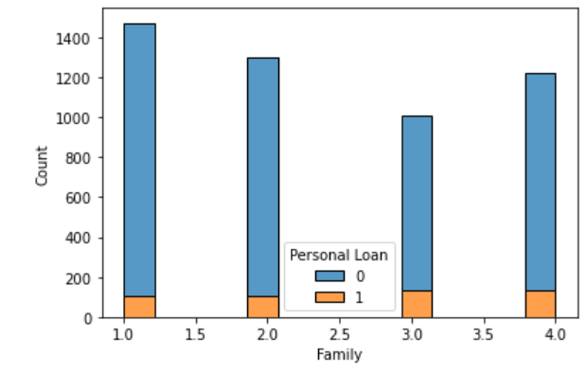
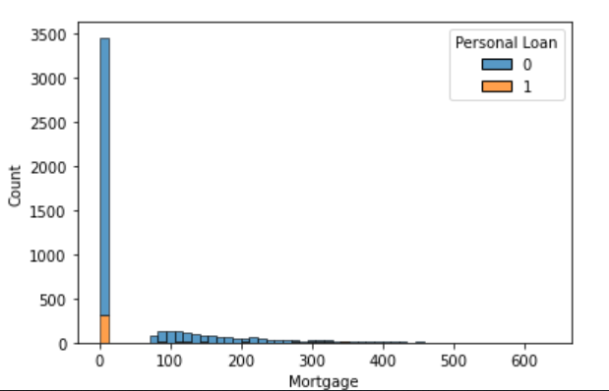
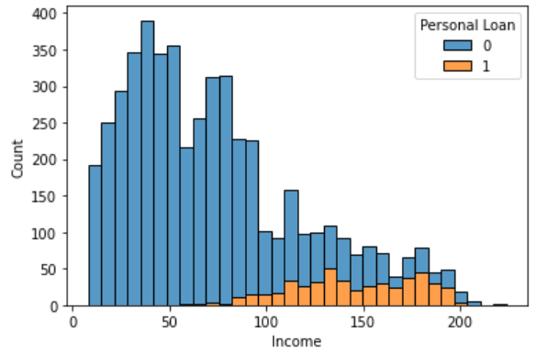
Exploratory Data Analysis
Age is normally distributed
Income skewed to the lower incomes
Experience has negative values

Slide 7
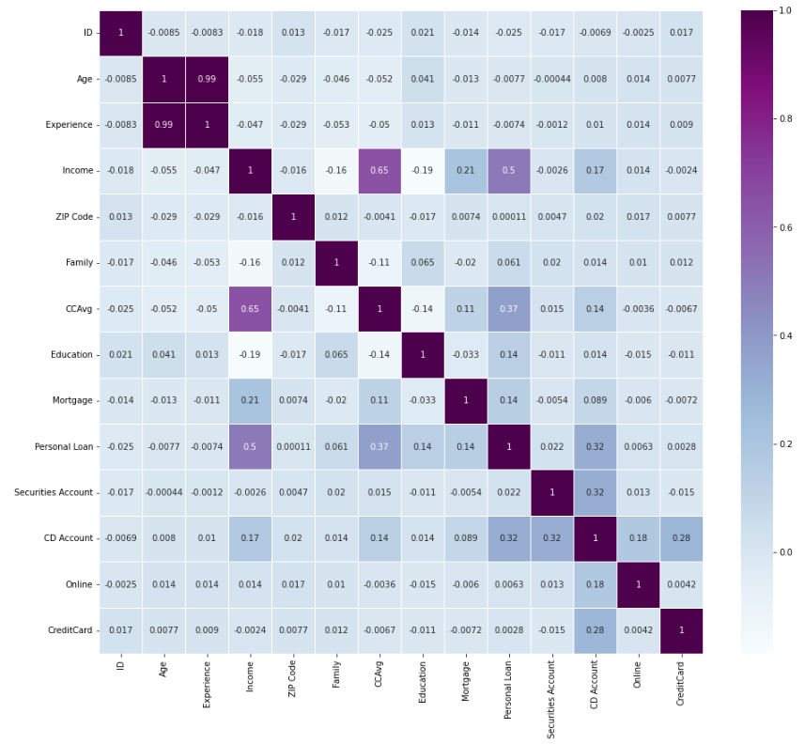
Exploratory Data Analysis

Slide 8
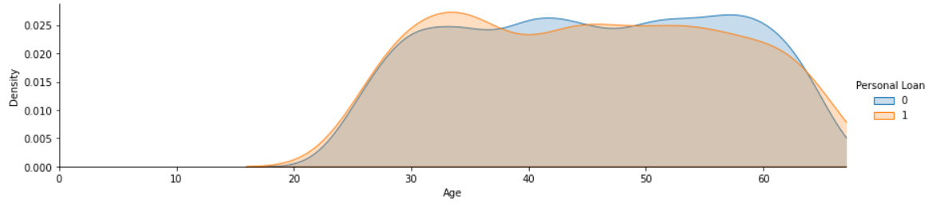
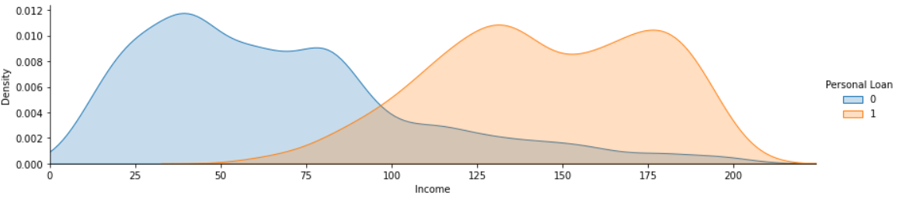

Slide 9
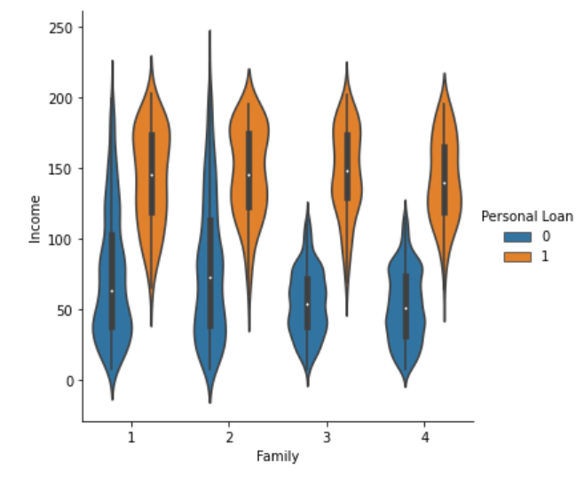
Income by Family Size
Everyone earning above 135K a year and has a family size of more than 3 has a Personal Loan

Slide 10
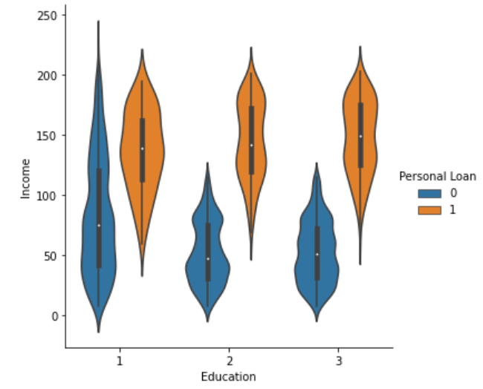
Income by Educational Attainment
Everyone earning above 135K a year and is a graduate has a personal loan

Slide 11
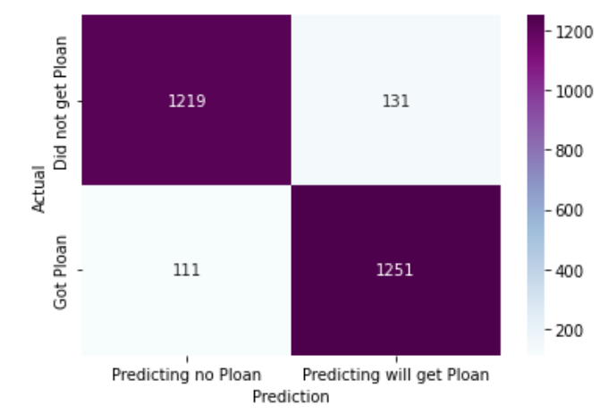
LOGISTIC REGRESSION
Parameters: solver = liblinear
METRIC | SCORE
Accuracy | 91.08%
Precision | 90.52%
Recall | 91.85%
F-1 | 91.18%
Ideally, minimise this as it does not cost as much to advertise to another person but profit is higher per each person

Slide 12
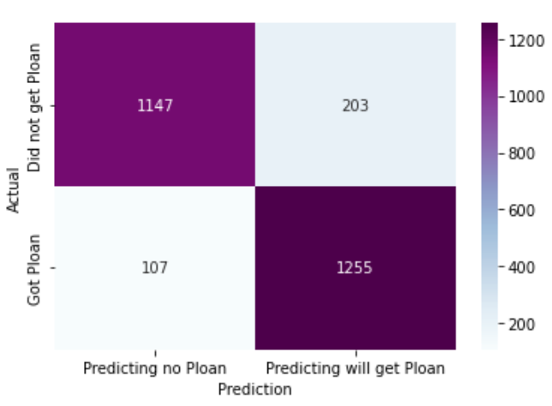
SUPPORT VECTOR MACHINE
Parameters: C=1, kernel = linear
METRIC | SCORE
Accuracy | 88.57%
Precision | 86.08%
Recall | 92.14%
F-1 | 89.01%
Ideally, minimise this as it does not cost as much to advertise to another person but profit is higher per each person

Slide 13
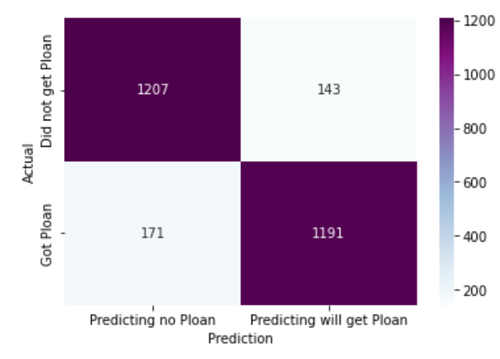
Gaussian Naïve Bayes
Default Parameters
METRIC | SCORE
Accuracy | 88.42%
Precision | 89.28%
Recall | 87.44%
F-1 | 88.35%
Ideally, minimise this as it does not cost as much to advertise to another person but profit is higher per each person

Slide 14
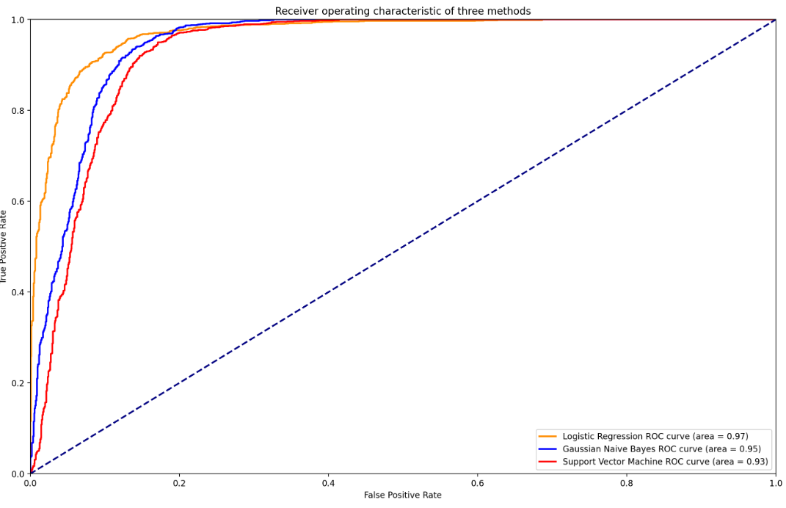
ROC AUC
70%
Can we plot Support vector machines?
There is no Predict Probabilities, I only used decision function for SVM
Is there a graph for false negatives?
50%
20%
If minimizing false positive rate is critical to the business question(i.e. convicting a suspect)

Slide 15
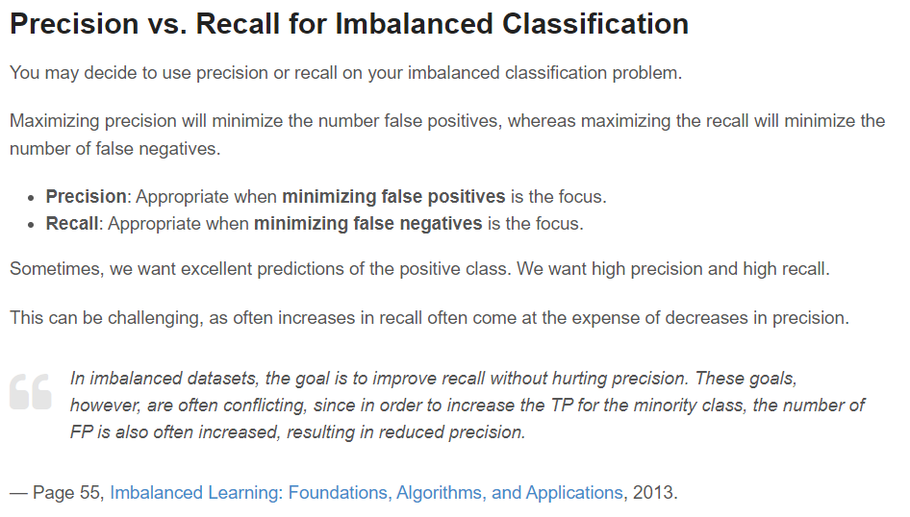
Recommended Model
Model | Accuracy | Precision | Recall | F1
Logistic Regression | 91.08% | 90.52% | 91.85% | 91.18%
Support Vector Machine | 88.57% | 86.08% | 92.14% | 89.01%
Gaussian Naïve Bayes | 88.42% | 89.28% | 87.44% | 88.35%

Slide 16
Cross Validation
Accuracy Scores
90.60%
92.57%
93.36%
92.69%
92.92%
Average Score : 92.37%

Slide 17
Logistic Regression Model

Slide 18
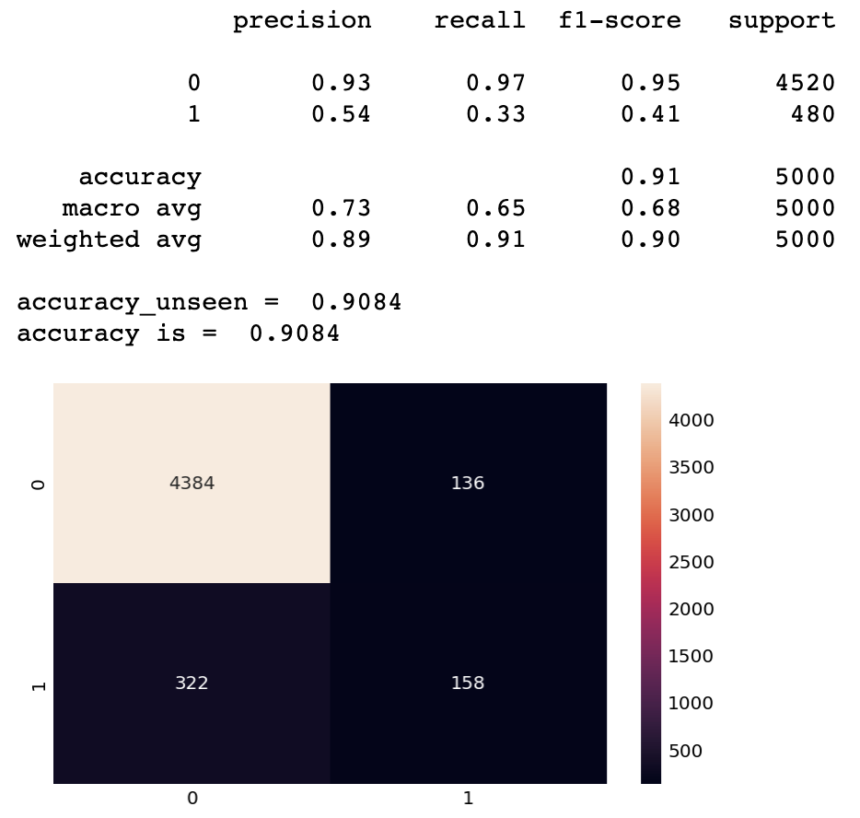
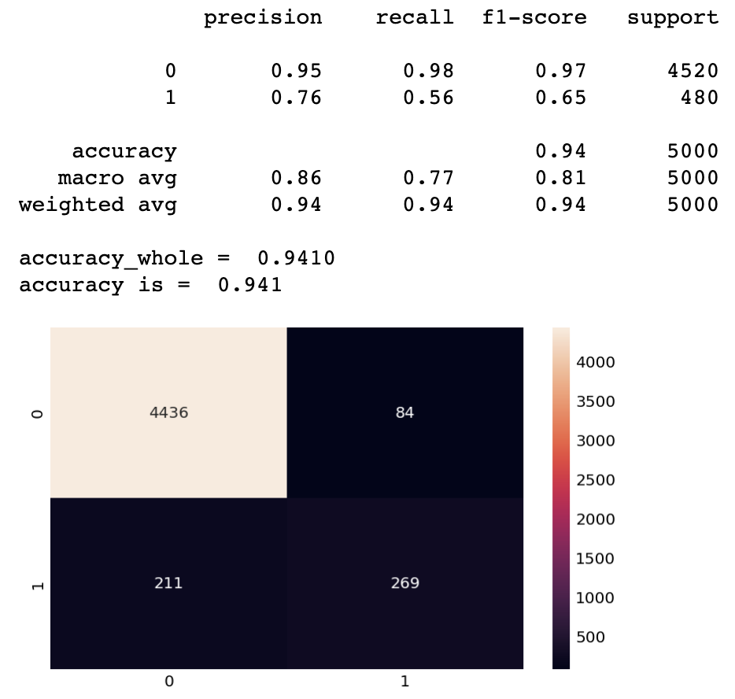
Logistic Regression Model
All features
Reduced features
Loss = -$335, 600
Gain = $158,000
Variance = -$177,600
Loss = -$219,400
Gain = $269,000
Variance = $49,600

Slide 19
Support Vector Machine

Slide 20
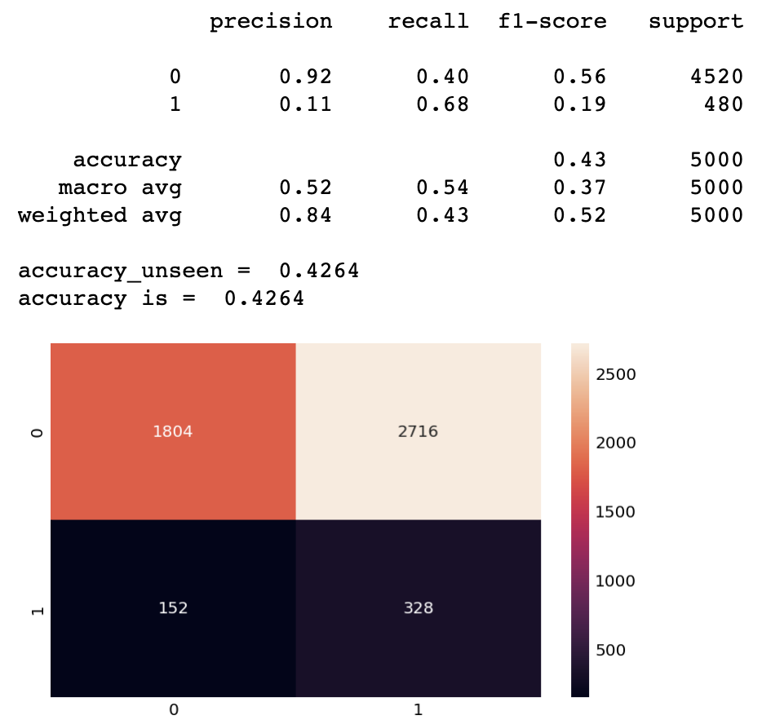
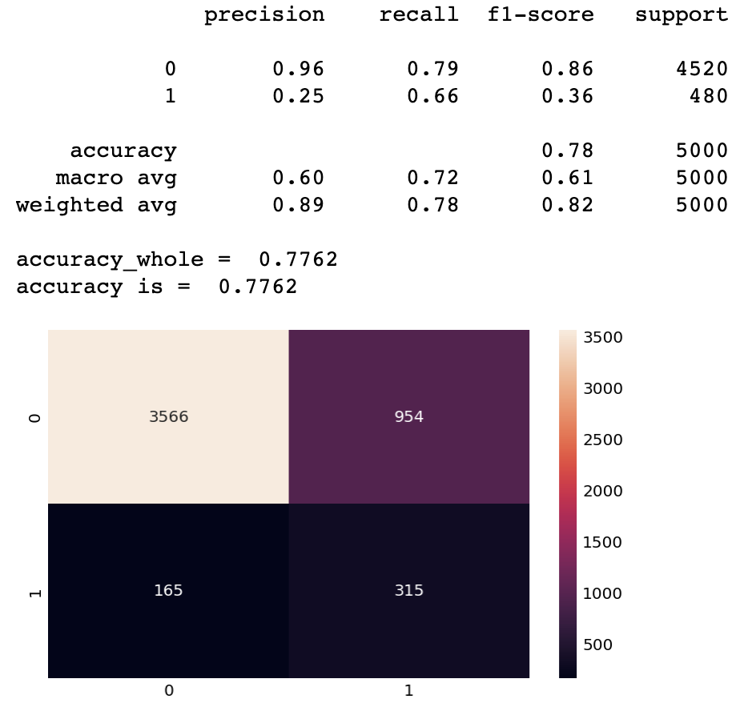
Support Vector Machine
All features
Reduced features
Loss = -$179160
Gain = $328,000
Variance = $148,840
Loss = -$260,400
Gain = $315,000
Variance = $54,600

Slide 21
Naïve Bayes

Slide 22
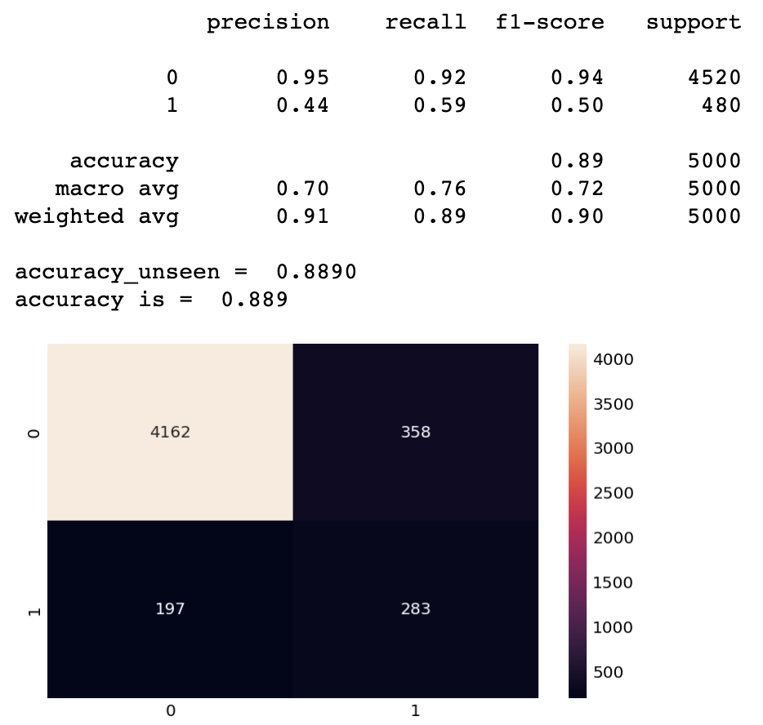
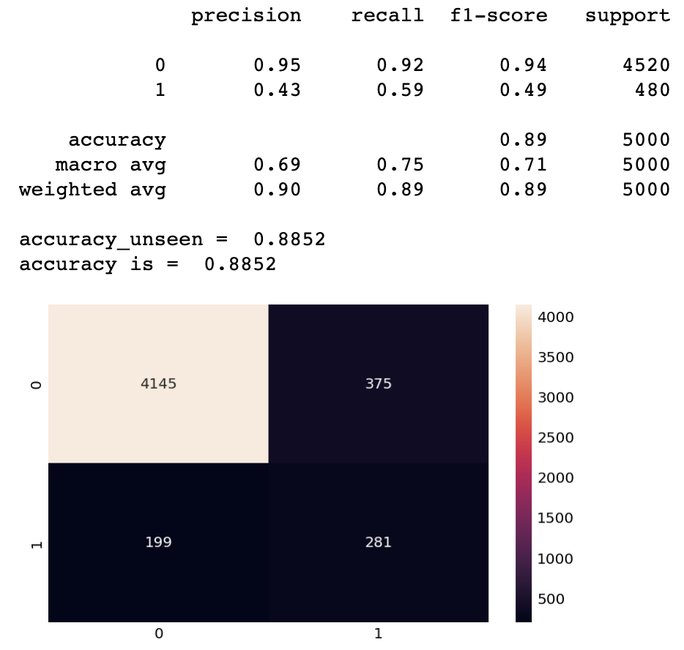
Naïve Bayes (income, family, education, ccavg, mortgage, cd_account, online)
All features
Reduced features
Loss = -$232,800
Gain = $283,000
Variance = $50,200
Loss = -$236,500
Gain = $281,000
Variance = $44,500

Slide 23
Conclusion
Support Vector Machine performs well when using all features and reduced features
Even though it doesn’t perform the best, but it will won’t cost the company and rather gain income during the observation phase of its deployment

